Slide 1

MedAssist
Patient Journey Companion
From Your Home to the Treatment Room
Roy Davidovich | Tal Ayoun | Kim Naishtut | Yasmin Diunina
Hub Workshop - 2026

Slide 2






The Team
RD
TA
KN
YD
Roy Davidovich
Tal Ayoun
Kim Naishtut
Yasmin Diunina
Project Lead
Full-Stack Development
Behavioral Research & UX
Content Strategy & Support
Computer Science
Computer Science
Psychology
Psychology
TECHNOLOGY
PSYCHOLOGY & UX

Slide 3
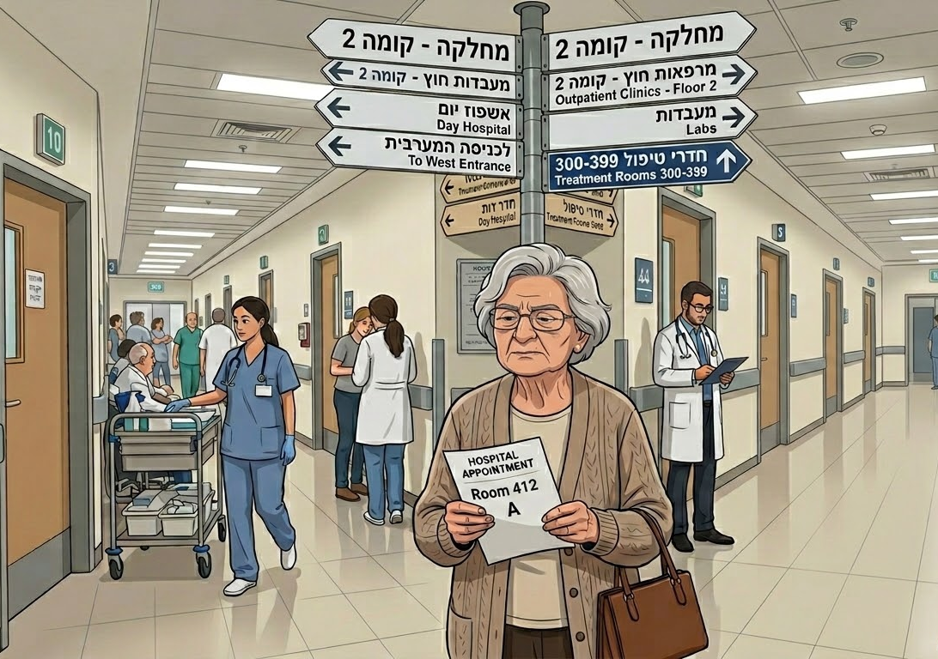
Case Study

Slide 4
The Cost of Inefficiency
Medical technology advances every year. Patient experience is stuck in the 90s
~4,500
~$556K
Annual staff hours spent guiding lost patients
annual loss per hospital from
cancellations & navigation
Sources: Artera 2026 | Emory University 2025 | Signes 2026

Slide 5
Preoperative Anxiety
The emotional toll of outdated healthcare journeys
8 out of 10 patients
experience clinical anxiety before a medical procedure
Sources: Artera 2026 | Emory University 2025 | Signes 2026

Slide 6


The Israeli Healthcare Leak
Quantifying the direct financial loss of missed hospital appointments
15% = 60,000
Missed Appointments Every Year
400,000
Annual Appointments
=
18M₪
Min. Total Annual Loss
60,000
Missed Appointments
x
₪300
Min. Cost per Slot

Slide 7
The Financial Gap
The staggering economic impact of patient no-shows
$150B
Annual cost of patient no-shows
in the United States alone
Sources: Artera 2026 | Emory University 2025 | Signes 2026

Slide 8
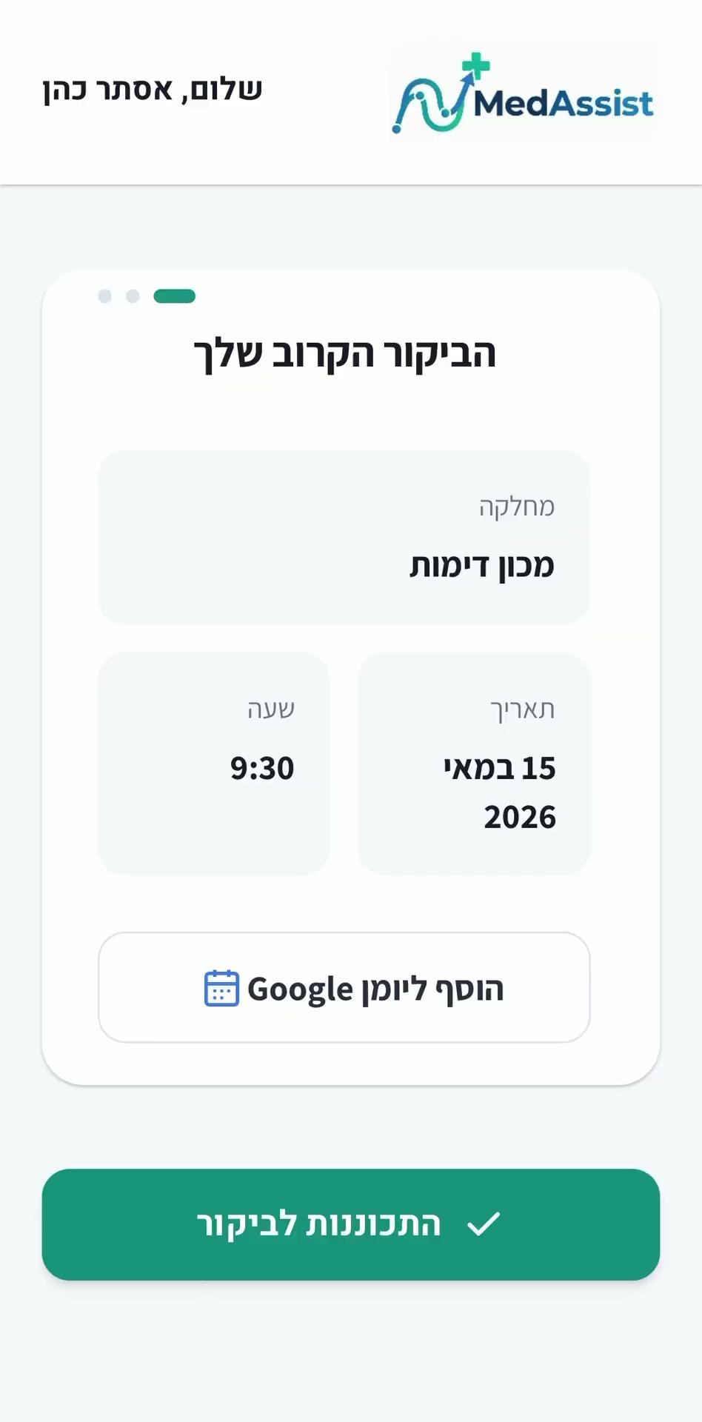
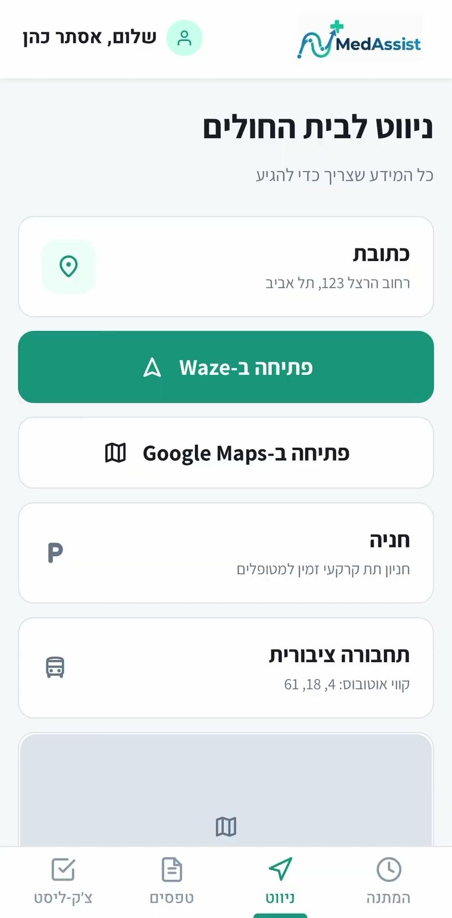
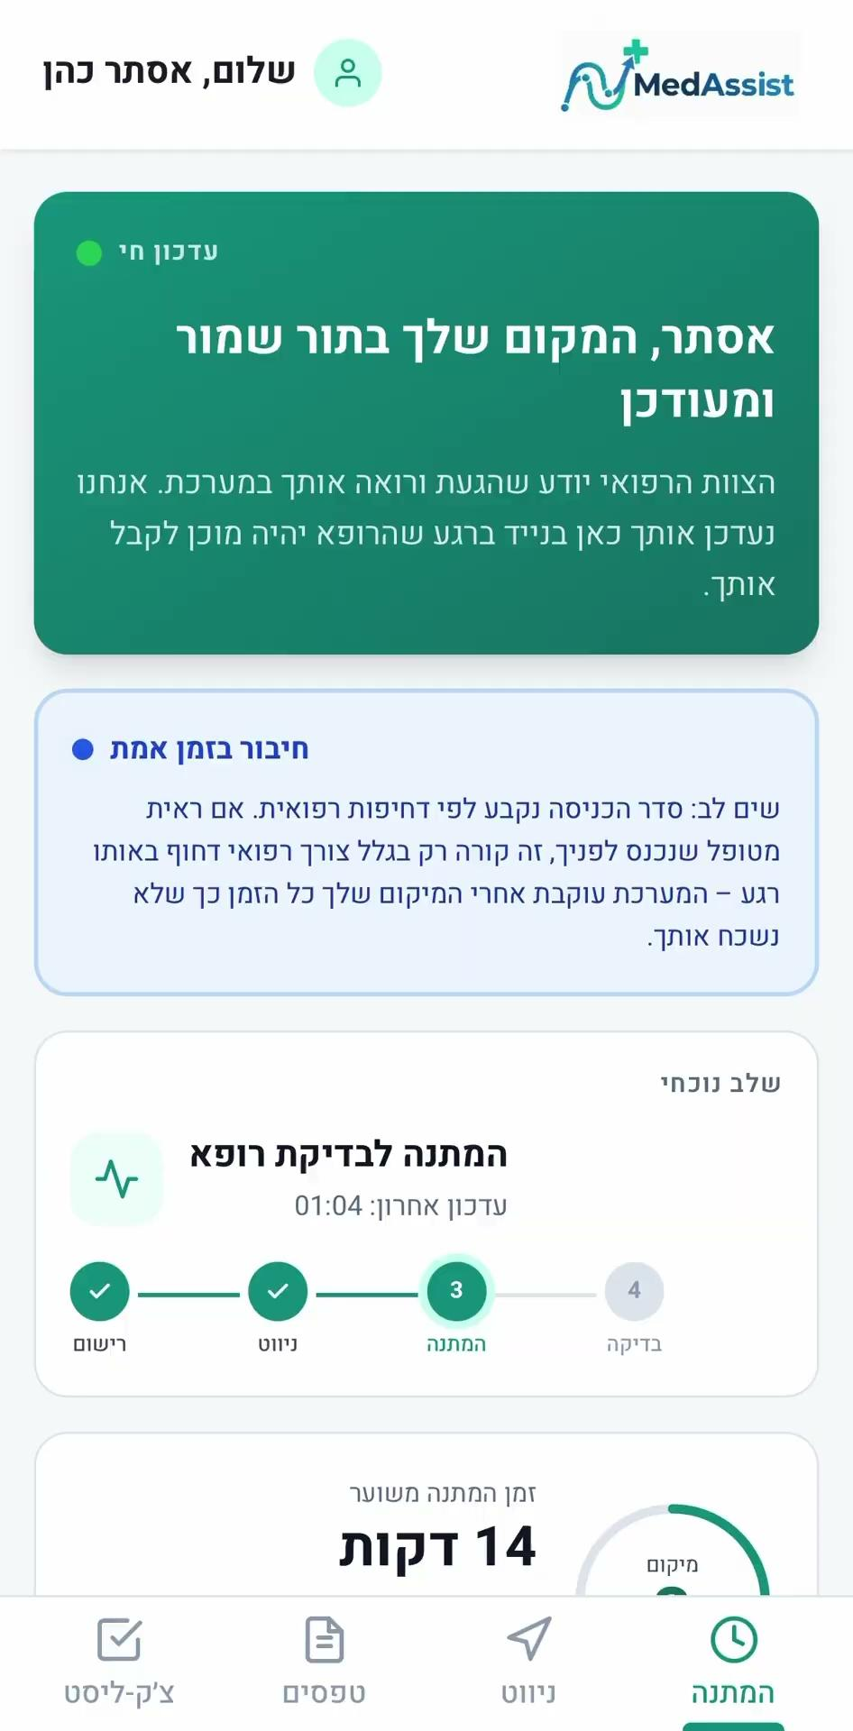
MedAssist
A web-based patient companion that follows the patient through every step of their hospital visit.
PREPARE
NAVIGATE
WAIT
No Download · No Account · No Password

Slide 9
Less Anxiety, Fewer Empty Slots
Driving financial efficiency through psychological friction reduction
₪18M X 0.38 = ₪6,840,000 saved
No-Show Rate
-38% No-Shows
Patient Anxiety
-30% Anxiety
Standard Care
With MedAssist

Slide 10
Market Opportunity
A $25B global market growing at 13% CAGR
TAM
SAM
SOM
CAGR
13%
$25B
$4B
$100M
Up to $45B
by 2030
Global market (2025)
Digitally-ready hospitals
2.5% of Digitally-Ready Market
Sources: The Business Research Company 2026 | Precedence Research 2026

Slide 11
Competitor Analysis
Bridging the industry's gaps: the only continuous, frictionless journey from pre-arrival to point-of-care
Prepare at home
Indoor navigation
Live wait screen
No download
Scalable
Navin
✗
✓
✗
✗
✓
Sheba App
~
✓
✓
✗
✗
Sheba First
✓
✗
✗
✓
✗
Mappedin
✗
✓
✗
✗
✓
MedAssist
✓
✓
✓
✓
✓

Slide 12



Measurable Impact
Three UN Sustainable Development Goals addressed - with targets we can measure within two years.
2-Year Targets:
38% fewer
appointment no-shows
30% less
anxiety on admission day
3,000 hrs/yr
returned to clinical care

Slide 13

Business Model
A friction-free entry strategy built for rapid adoption, scaling into exponential ARR growth.
Year 1: Low-Friction Entry
Q1 - Pilot
FREE
Q2 - Q4
₪200K
Projected Annual Recurring Revenue (ARR)
Year 2+: Shared Success
Model
ROI-Driven Subscription
Pricing Scale
Value-Based
Revenue (ILS)
Year 1
Year 2+

Slide 14
6-Month Development
MVP in 6 months. First hospital pilot in Q1 2027.
Q1-2027 Launch
User journey mapping
May '26
Navigation engine dev.
Jun - Jul '26
Cloud infra + SMS
Jul - Aug '26
UI/UX interface design
Jun '26
Full-Stack code + PWA
Jul - Aug '26
Marketing & branding
Aug - Sep '26
Total budget: ₪250,000 development + ₪250,000 pilot

Slide 15

$150B
is the problem
0 friction
for max. user adoption
38% less
No-shows

Slide 16
Thank you for listening
Roy Davidovich | Tal Ayoun | Kim Naishtut | Yasmin Diunina
Hub Workshop - 2026

